Slide 1
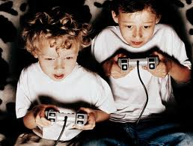
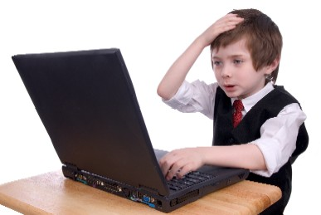
Research from Last Child In The Woods
by Richard Louv (2005)
Children are spending 40 to 65 + hours a week using electronics
Fewer than 1 in 5 children walk or ride a bike to school
Children have less time for unstructured, creative play in the outdoors than ever before in human history
Childhood obesity has increased from 4% in 1960 to 20% today

Slide 2
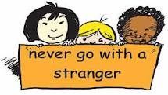
The Cause
Restricted access to natural areas
Overprotective, fearful parents
Less time free to play
More time kept indoors

Slide 3
The Consequences
Lack of respect for natural resources
Unhealthy lifestyle choices
Dulled senses
Decreased empathy for plants and animals
Lower performance in school
Destructive and apathetic behaviours towards others
Higher numbers of A.D.H.D and other disorders
Lower self-confidence and independence
Diminished creativity

Slide 4
Every Experience Matters By Dr Karen Malone 2008
Review of over 50 respected studies from around the globe. Majority USA and England and four from Australia.
Focused on children from pre school up to tertiary education
locations included school grounds, galleries, museums, field centres, gardens, parks and playgrounds, wilderness, community, urban spaces, camps.

Slide 5
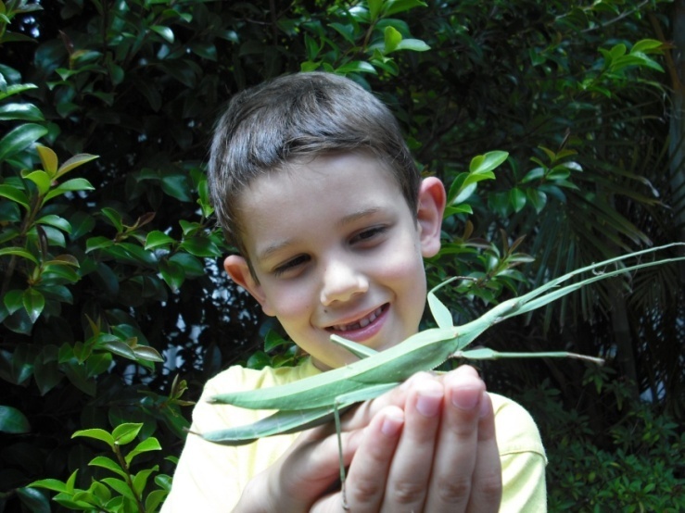
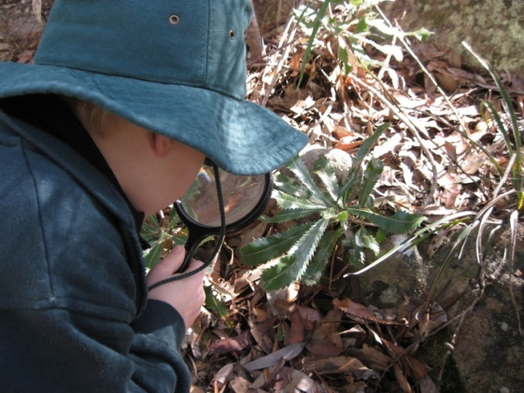
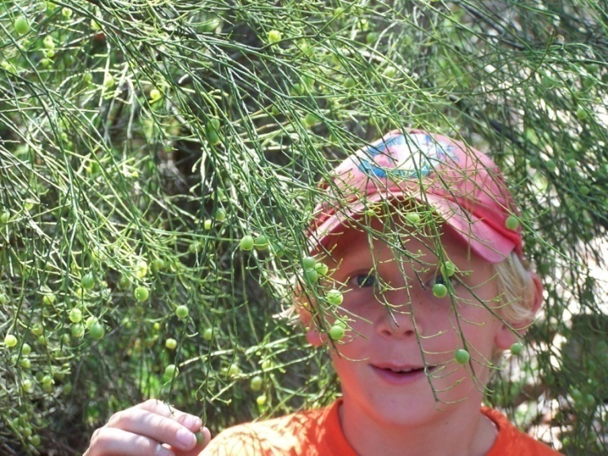
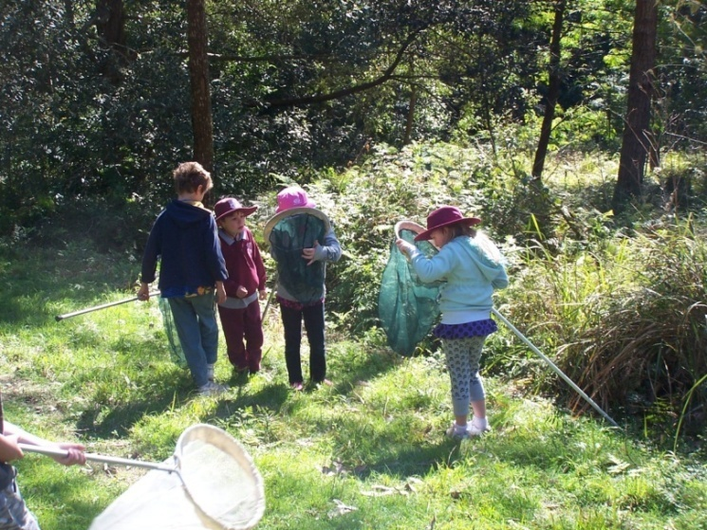
Children are happier, healthier, more intelligent and well adjusted when they are connected with nature

Slide 6
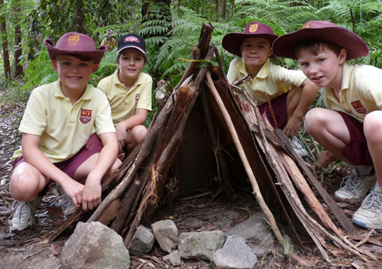
Happier Children
Nature play increases self esteem, improves psychological health and reduces stress. Children learn self-discipline and are more cooperative
“I feel better about myself. I think that I can do more and I’m proud of myself” (Rachel, aged 13).

Slide 7
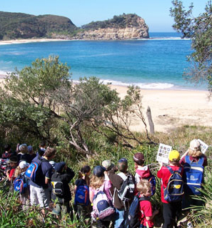
Healthier Children
Nature play improves physical wellbeing by boosting the immune system, enhancing coordination, strength, and helping maintain a healthy weight.
“It’s noisy in the classroom and it’s hard to concentrate, sometimes I would pretend to go to the toilet just to get out, get fresh air and move my body”
(Sasha, aged 8).

Slide 8
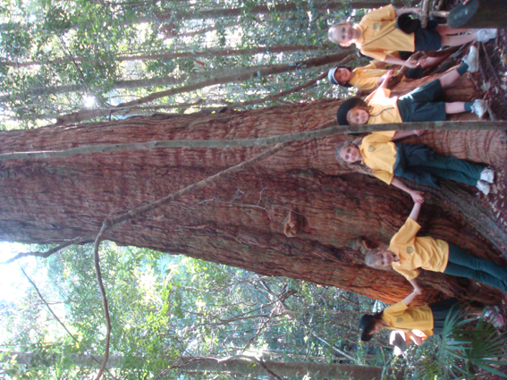
Intelligent Children
Nature play stimulates creativity and improves decision making and problem solving.
Children tend to do better in school and score higher on tests.
Increase in environmental & geographical literacy
“Because if you just read stuff out of a book, it’s not really enjoyable and you don’t really remember it. But if you go there then you’ll enjoy yourself, you’ll have great fun and it’ll stick in your mind” (Secondary School student).

Slide 9
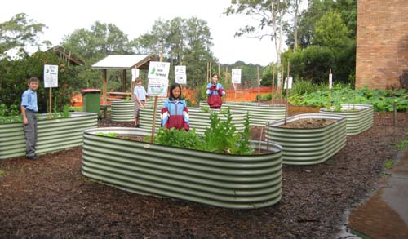
Social Interactions
Sense of community
Social skills and behaviours
Connectedness inner and outer worlds
Engaging with others
sociability
“I’d say that you learn mostly how to interact with different kinds of people and are open to different ideas. You learn how to cooperate well with others who share and don’t share the same opinions as you” (Teo, aged 14).

Slide 10
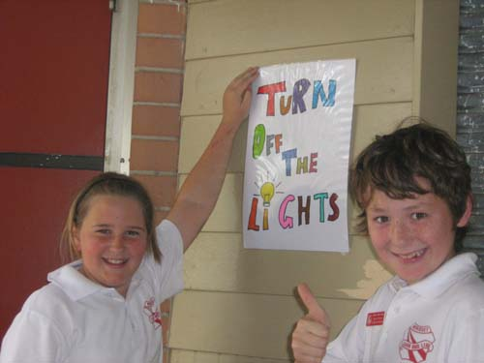
Responses & action
Increase in values and attitudes, tolerance and empathy
Sense of environmentally responsibility
Risk assessment and resilience
“Before we went on the trip . . . I didn’t really care about like people moving into houses and building stuff. But I’ve like realised like cos . . . when we saw the wildlife what would be damaged if they blitz that. And before I didn’t really care but it has changed my view” (Secondary School student).

Slide 11
Research is supported by
United Nations Decade of Education for sustainable development
The Hunter Central Coast Regional Environmental Education Strategy developed by Regional Environmental Education Working Group
DEC Sustainability Education Policy 2012

